Slide 1
ELECTRICAL SCIENCE-1
(15B11EC111)
Unit-7
Electrical Instruments
( Essentials of an Instrument, Permanent Magnet Moving Coil (PMMC) Instruments, voltmeter, ammeter, Ohmmeter, Meter Sensitivity (Ohms Per-Volt Rating); Loading Effect; Multimeter; Cathode Ray Oscilloscope: Construction, Working and Applications. Function Generators )
Lecture-2
Dr. Abhishek Kashyap
Assistant Professor (Senior Grade, JIIT Noida)

Slide 2
Topics to be covered
GRAVITY CONTROL
DAMPING TORQUE
AMMETERS AND VOLTMETERS
PROBLEMS
PRACTICE PROBLEMS
REFERENCES

Slide 3
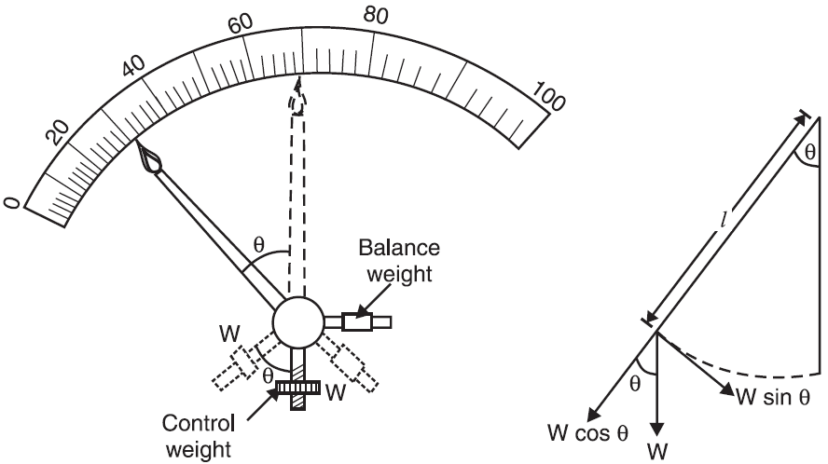
Gravity Control
In this method, a small adjustable weight W is attached to the moving system which provides the necessary controlling torque.
In the zero position of the pointer, the control weight hangs vertically downward and therefore provides no controlling torque.
However, under the action of deflecting torque, the pointer moves from zero position (from left to right) and control weight moves in the opposite direction.

Slide 4
Gravity Control
Due to gravity, the control weight would tend to come to original position (i.e. vertical) and thus provides an opposing or controlling torque. The pointer comes to rest at a position where controlling torque is equal to the deflecting torque.

Slide 5
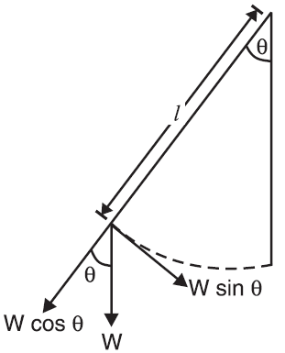
Gravity Control
In the deflected position, weight W can be resolved into two rectangular components viz W cos θ and W sin θ.
Only the component W sin θ provides the controlling torque T_{C}.
∴ T_{C} = W l sin θ
or T_{C} ∝ sin θ (for fixed W and l)
For example, in a permanent-magnet moving coil instrument, the deflecting torque is directly proportional to the current flowing through the operating coil i.e.
T_{d} ∝ I
With gravity control, T_{C} ∝ sin θ
In the final deflected position, T_{d} = T_{C}
∴ I∝ sin θ

Slide 6
Gravity Control
Since I is proportional to the sine of angle of deflection, gravity-controlled instruments have non-uniform scales
Advantages
It is slightly cheaper in manufacturing costs than spring control.
It is unaffected by temperature variations.
It is not subjected to fatigue.
The controlling torque can be changed easily.
Disadvantages
The instrument has to be kept in vertical position.
The control weight increases the weight of the moving system.
Gravity-controlled instruments have non-uniform scale.

Slide 7
Example
The deflecting torque of an ammeter is directly proportional to the current passing through it, and the instrument has full scale deflection of 70° for a current of 10 A. What deflection will occur for a current of 5 A when the instrument is (i) spring-controlled (ii) gravity controlled?

Slide 8
Solution
Deflecting torque, T_{d} ∝ I
(i) Spring-controlled.
Controlling torque, T_{C} ∝ θ ∴ I ∝ θ
In the first case, 10 ∝ 70°
In the second case, 5 ∝ θ
∴ θ = (5/10) × 70° = 35°

Slide 9
Solution
Deflecting torque, T_{d} ∝ I
(ii) Gravity-controlled.
Controlling torque, T_{C} ∝ sin θ ∴ I ∝ sin θ
In the first case, 10 ∝ sin 70°
In the second case, 5 ∝ sin θ
∴ sin θ = (5/10) sin 70° = 0.47
or θ = sin^{–1} 0.47 = 28°

Slide 10
Example
In a gravity-controlled instrument, the controlling weight is 0.005 kg and acts at a distance of 2.4 cm from the axis of the moving system. Determine the deflection in degrees corresponding to deflecting torque of 1.05 × 10^{–4} kg m.

Slide 11
Solution
Controlling weight, W = 0.005 kg ;
Lever arm, l = 2.4 cm = 0.024 m
∴ Controlling torque, T_{C} = Wl sin θ = 0.005 × 0.024 × sin θ = 0.00012 sin θ
In the final deflected position, T_{d} = T_{C}
∴ 1.05 × 10^{–4} = 0.00012 sin θ or θ = 61°

Slide 12
Damping Torque
If the moving system is acted upon by deflecting and controlling torques alone, then pointer, due to inertia, will oscillate about its final deflected position for quite some time before coming to rest.
This is often undesirable because it makes difficult to obtain quick and accurate readings.
In order to avoid these oscillations of the pointer and to bring it quickly to its final deflected position, a damping torque is provided in the indicating instruments.
This damping torque acts only when the pointer is in motion and always opposes the motion.
The position of the pointer when stationary is not affected by damping.

Slide 13
Damping Torque
Note. The moving system of an indicating instrument experiences three torques while in motion and two torques when it has come to rest in the final deflected position.
During motion, the deflecting torque due to the quantity being measured is opposed by controlling torque and damping torque.
When the pointer comes to rest in the final deflected position, damping torque is zero and the controlling torque is equal to the deflecting torque.

Slide 14
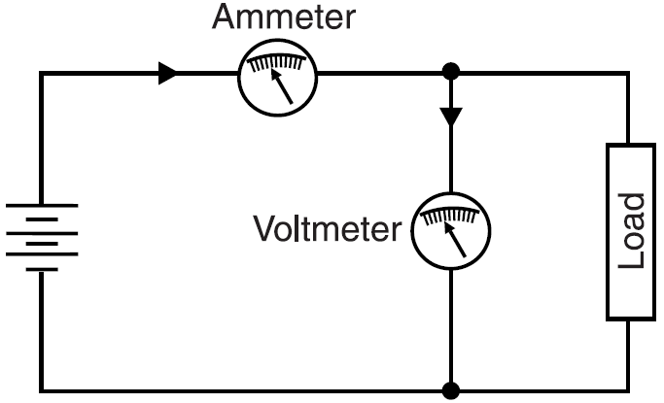
Ammeters and Voltmeters
An ammeter is used to measure the flow of current in a circuit. It is thus connected in series with the circuit under test so that current to be measured.
The ammeter must be capable of carrying this current without injury to itself and without abnormally increasing the resistance of the circuit into which it is inserted.
For this reason, an ammeter is designed to have low resistance.

Slide 15
Ammeters and Voltmeters
A voltmeter is used to measure the potential difference between two points of a circuit. It is thus connected in parallel with the circuit.
The voltmeter must have enough resistance so that it will not be injured by the current that flows through it, and so that it will not materially affect the current in the circuit to which it is connected.
For this reason, a voltmeter is designed to have high resistance.

Slide 16
References
Charles K. Alexander (Author), Matthew N.O Sadiku, “ Fundamentals of Electric Circuits”, 6th ed, Tata Mc Graw Hill, 2019..
D.C. Kulshreshtha, Basic Electrical Engineering, Revised 1st ed, Tata Mc Graw Hill, 2017.
V. K.Mehta, Rohit Mehta, Basic Electrical Engineering, 6th ed, S. Chand Publishing, 2012.

